Slide 1
UNIT 4: DID YOU GO TO THE PARTY?
LESSON 1

Slide 2
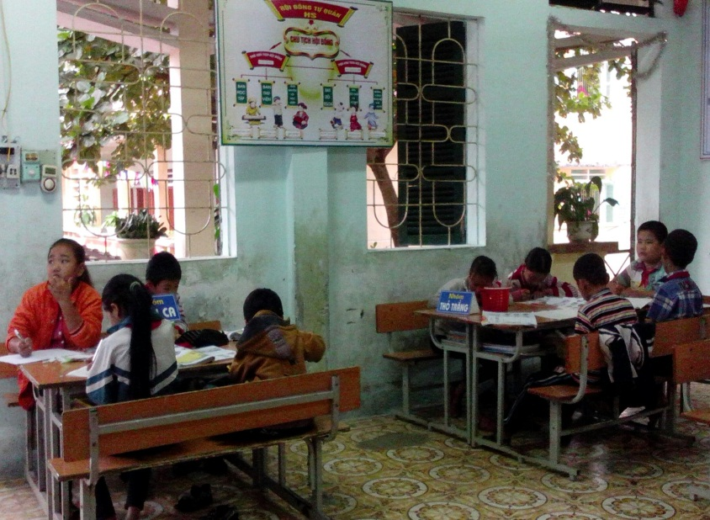
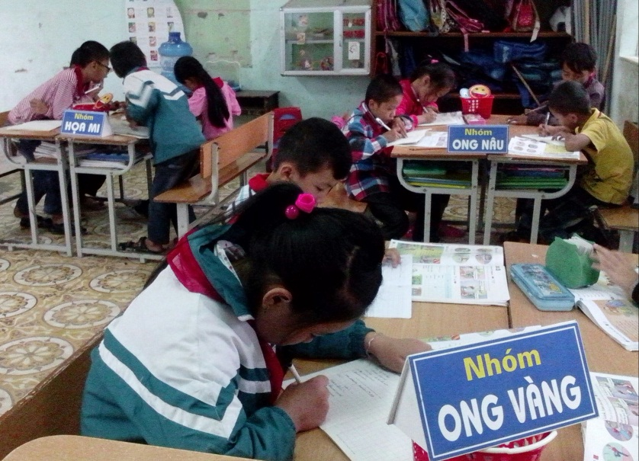


LÝ THƯỜNG KIỆT SCHOOL
WELCOME TO OUR CLASS
Class: 5A
Teacher: Đinh Thị Lệ Quyên

Slide 3

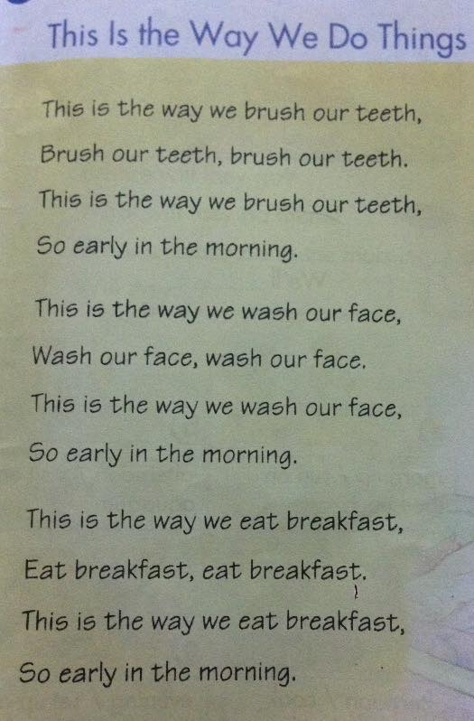
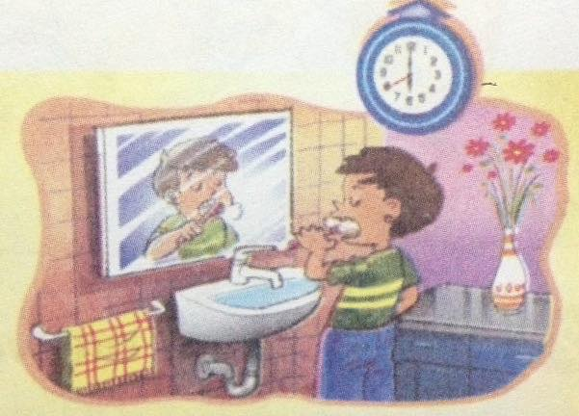
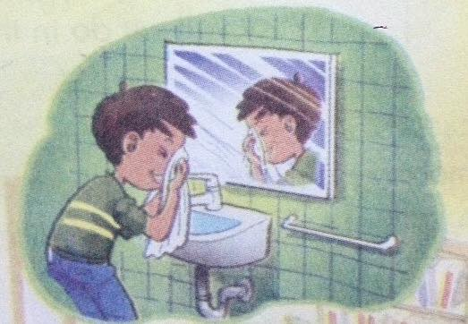
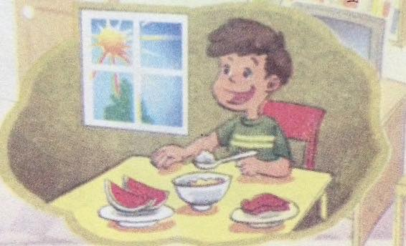

Thursday , October 29th 2015
* Warm up:
Sing a song.

Slide 4
Thursday ,September 29th 2016
UNIT 4:
Did you go to the party?
Lesson 1
1. Look ,listen and repeat :
a lot of Party Think – thougth Fun | Nhiều Bữa tiệc Suy nghĩ Vui
cartoon | phim hoạt hình
chat | nói chuyện phiếm
funfair | hội chợ vui chơi
invite | mời
join | tham gia
take part | tham gia
Let’s talk
Let’s talk
2
Let’s talk

Slide 5
Tuesday , October 4th 2016
UNIT 4:
Lesson 1
2. Point and say
Did you _____________? Bạn có làm gì đó hay không ?
Yes, I did
No , I didn’t
Vd: Did you go to the party ?
Yes, I did
No, I didn’t
Hành động
2
7
Let’s talk
4

Slide 6
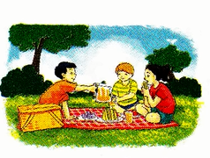
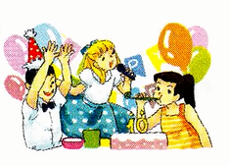


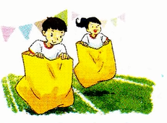
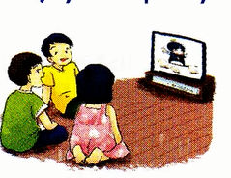


Did you _____________?
Yes, I did
No, I didn't

Slide 7
UNIT 4: Lesson 2
Look, listen and repeat
Eat – ate : ăn
Sing – sang : hát
Dance – danced : nhảy
Have – had
Play - played
Chat - chatted
Watch – watched
Anything else : còn gì nữa
Comic book : truyện cười
Book fair: hội chợ sách
Sport festival : lễ hội thể thao

Slide 8
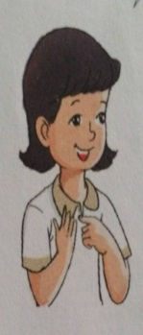
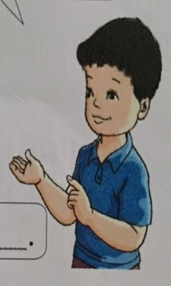
2. Point and say .
What did you do at the party ? Bạn đã làm gì ở buổi tiệc?
We ……….
Hoạt động ở quá khứ
Studied Math , Vietnamese and English.

Slide 9


Play game: The bee find word.
vẽ
Sing a song
dance
đi xe đạp
draw
hát một bài
Ride a bike
nhẩy

Slide 10



HOMEWORK:
-Ghi mỗi cụm từ mới 1 dòng
- Làm point, ask and answer vào vở.

Slide 11


Goodbye.
See you again!

